Slide 1
Installation Guide
(Servlet Container – Tomcat 6.0.18)
2009. 01. 06
CODELABOR
Shin Sang Jae (codelabor@gmail.com)

Slide 2
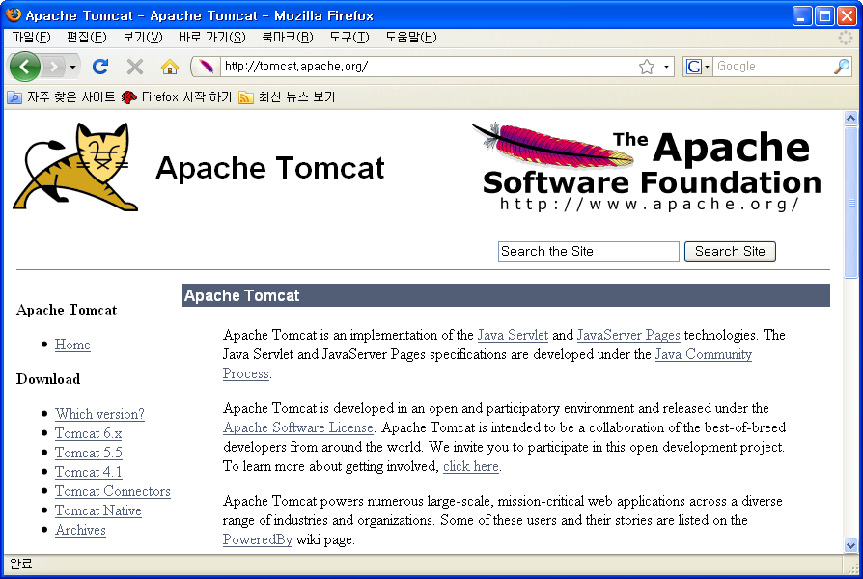

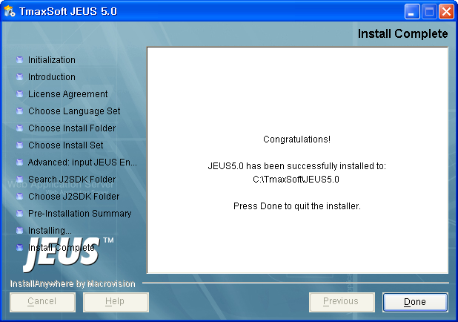
Servlet Container
Installation
Official Site URL: http://tomcat.apache.org
Download Site URL: http://tomcat.apache.org/download-60.cgi
File: apache-tomcat-6.0.18.exe

Slide 3
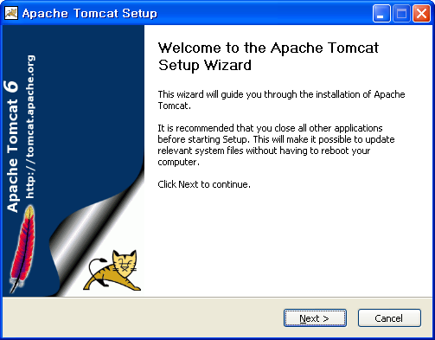
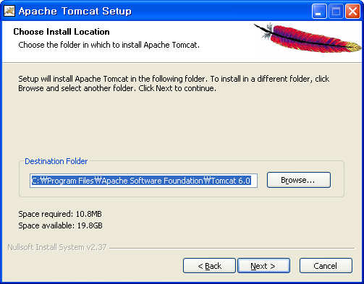
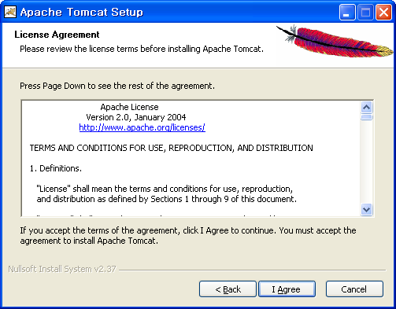
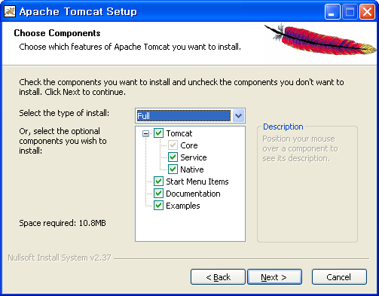
Servlet Container
Installation
Type: Full
Install directory: C:\Program Files\Apache Software Foundation\Tomcat 6.0

Slide 4
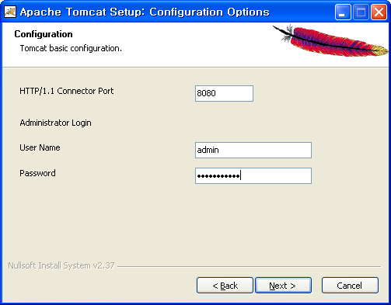
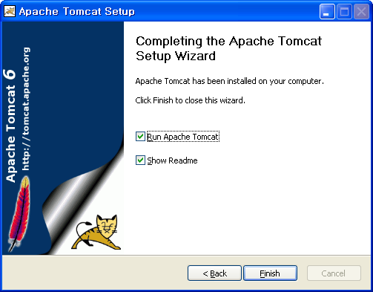
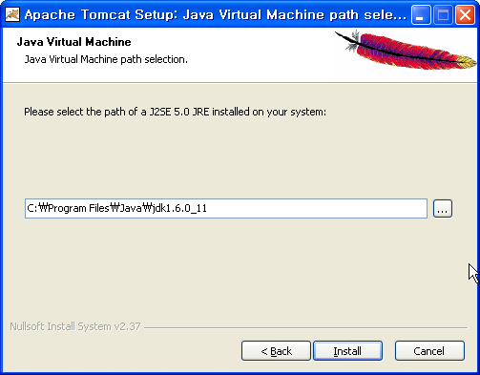
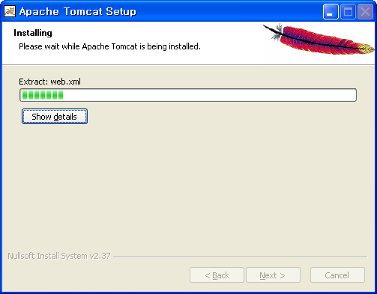
Servlet Container
Installation
Password: tomcatadmin
J2SE 5.0 JRE Path: C:\Program Files\Java\jdk1.6.0_11

Slide 5
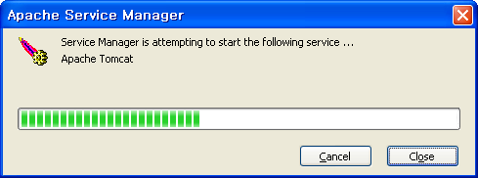
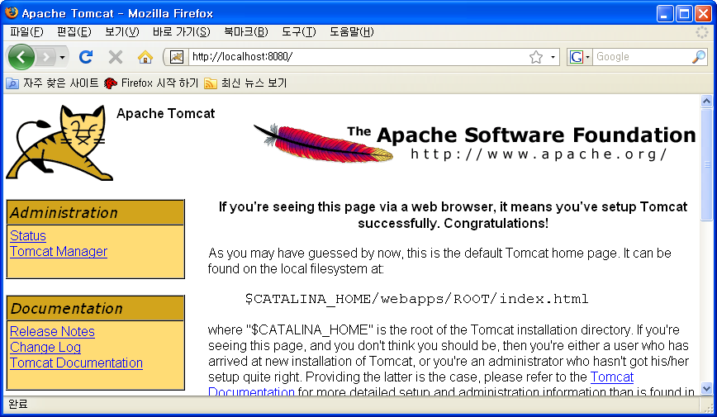
Servlet Container
Run
URL: http://localhost:8080

